Slide 1


DDoS Detection Using Machine Learning Algorithms
Under the Guidance of Professor Vahid
Project By Suneel Kumar

Slide 2
Motivation of Project
A distributed denial of service (DDoS) attack is a malicious attempt to make an online service unavailable to users, usually by temporarily interrupting or suspending the services of its hosting server.
01
DDoS attacks can be prevented by detecting the network services and related attacks and creating awareness to users to identify the DDoS Attacks.
03
DDoS and DoS are major threat to any legitimate clients using network services. One should be aware of these attacks.
02

Slide 3
Approach and Resources
In this project, we are going to detect different DDoS attacks by various methods and evaluate their performance. This is a Classification task. These DDoS detectors could be used for future reference.
Common DDoS attack types:
1) UDP Flood 2) TCP_SYN Flood 3) ICMP Flood
Dataset : The corrected.csv file is KD99 generated dataset. Uploaded to Python Language and Version : Python 3.8.8
Packages : NumPy, Sklearn, Pickle, tqdm, Pandas, Seaborn and Matplotlib.
Techniques : K-Nearest Neighbors, Decision tree, Multi-layer Perceptron and Logistic Regression.
Platforms : Jupyter Notebook and IDLE

Slide 4
Methodology
Dataset from Kaggle
Data Cleansing
EDA
Visualizations
Models

Slide 5
Pre-processing
Checking NAN values.
Before the extracted data can be used by the ML model, it needs to be normalized or pre-processed.
Common DDoS attacks are UDP Flood, TCP_SYN Flood and CMP Flood.
Splitting it in train and test and creating a confusion Matrix.
Executing the Machine Learning Models.
The trained model can be used now to detect the DDoS attacks.

Slide 6
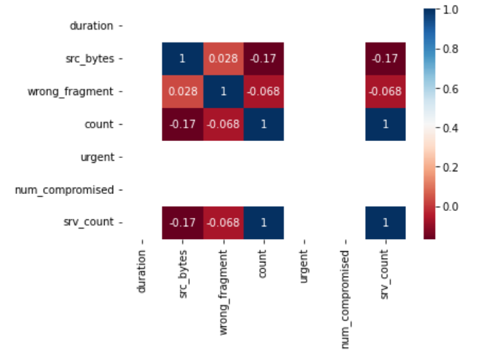
Correlation Heat Map for ICMP Flood

Slide 7
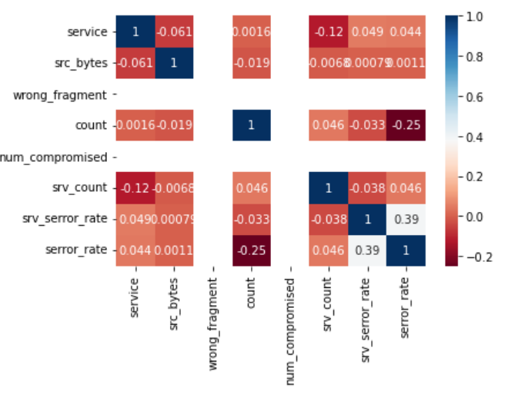
Correlation Heat Map for Tcp Flood

Slide 8
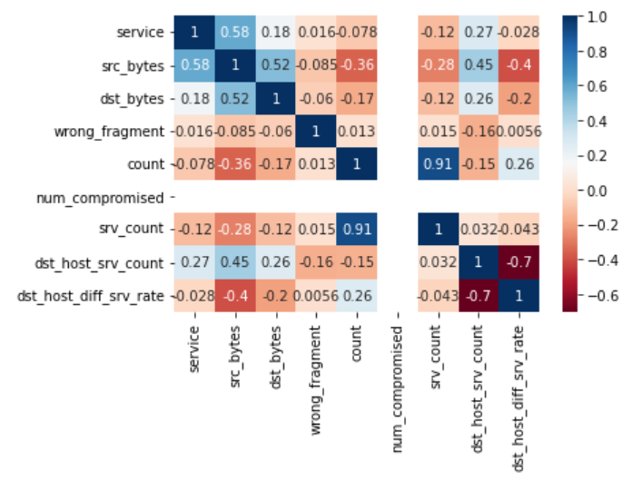
Correlation Heat Map for UDP Flood

Slide 9
Models' evaluation
1) Logistic Regression
2) Decision tree
3) KNN classifier
4) Multi-Layer Perceptron
5) Random Forest

Slide 10

Training Set and Test Set
Data has been divided into training and test data.
80% of train data
20% of test data

Slide 11
Model Building
Each Model is constructed that enables us to predict the value of new data considering the training data used to train the model.
Fit or Train the training data for each model.
Evaluate prediction accuracy score for each model.
Calculate the Scores, Confusion Matrix and Classifiers for each model.

Slide 12
Evaluation methodology
Creating the python files on 3 different DDoS attacks implementing all Machine Learning Algorithms in each file. The Py files which is train.py and test.py for fitting our best models with trained and test data.
In each python files I have distinguished each model's performance and used the best 2 models in train.py, Training the Model : Using Command python train.py icmp 0
Testing Our Model : Using Command python test.py tcp_syn -1.5 1.0 2.0 30.0 1.0
Methodology for evaluating a feature selection algorithm is applied on the raw data in order to reduce the number of variable and assess their importance in the accurate prediction and detection of DDOS attack.
A new customized dataset is thus obtained, and further machine learning algorithms are applied to it.
Model with the highest accuracy is chosen for detection of DDOS attacks.

Slide 13
Summaries of Training and Test Data
Model | Accuracy ICMP | Accuracy TCP | Accuracy UDP
Logistic Regression | 99.81 | 99.94 | 71.13
KNN | 99.99 | 99.98 | 74.43
MLP | 99.78 | 99.94 | 70.65
Decision Tree | 99.99 | 100 | 77.19

Slide 14
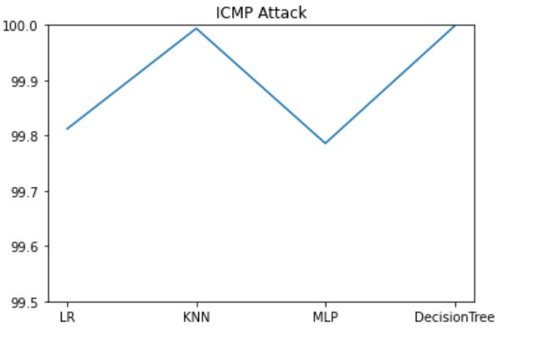
ICMP Flood Analysis between Classifiers and Scores

Slide 15
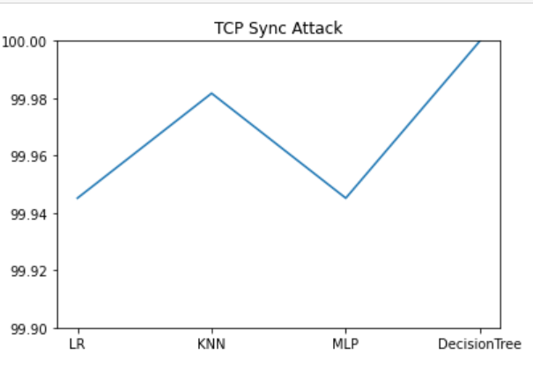
TCP Flood Analysis between Classifiers and Scores

Slide 16
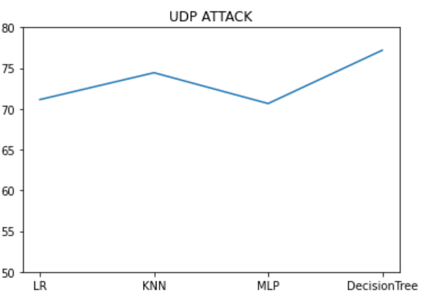
UPD Flood Analysis between Classifiers and Scores

Slide 17
Summary
We evaluated DDoS attacks prediction using Kaggle dataset which gives an accuracy of 100% with Decision Tree Classifier Model.
The most relevant features used for this prediction are service,src_bytes,dst_bytes,wrong_fragment,count,num_compromised,srv_count, dst_host_srv_count, dst_host_diff_srv_rate by filtering out outliers and irrelevant features of the dataset.
This Decision Tree model gives us good accuracy when compared to the other models.

Slide 18
Presentation Link
https://youtu.be/2RcEMTiljU0

